Slide 1
Paper Review
Data Mining Privacy Preserving: Research Agenda
Subject: Data Mining
Lecturers: PHAUK Sokkhey & CHAN Sophal
Presenter: Choeng Veyseng
Academic Year: 2021 - 2022

Slide 2
Table of Content
Paper Introduction
Why PPDM?
Literature Review
Methodology
Results
Future Research
Conclusion
1
2
3
4
5
9
10

Slide 3
Paper Introduction
Page 1
Data Mining Privacy Preserving: Research Agenda
Inda Kreso, Amra Kapo & Lejla Turulja
Wiley, WIREs: Data Mining and Knowledge Discovery
DOI: 10.1002/widm.1392
Accepted: 27 August 2020
Objectives:
To identify the current trends, techniques and methods that are used in Privacy Preserving Data Mining (PPDM)
To make a clear and precise classifications of these findings
To propose a methodology of doing Privacy Preserving Data Mining (PPDM)
To discuss about future research and make conclusion
Keywords:
bibliometric analysis, data mining, privacy preserving data mining, privacy preserving methods, privacy preserving techniques

Slide 4
Why PPDM?
Page 2
To protect individual privacy in the process of data mining
To remove unwanted data for doing data analysis
To provide a clear tatic to avoid leaking sensitive personal information

Slide 5
Literature Review
Page 3
Privacy-preserving Data Mining
Introducing the definition and reason of having PPDM
Showing the needs and the importances of doing PPDM
Techniques and Methods
Showing various tools and techniques using for PPDM
Discussing on the details of flows of PPDM

Slide 6
Methodology
Page 4
Planning Stage
Identify the need of the systematic review
Develop review protocol
Evaluate review protocol
Conducting Stage
Search of primary studies
Select primary studies
Extract data from primary studies
Assess quality of primary studies
Syntheze data
Reporting Stage
Select primary studies

Slide 7
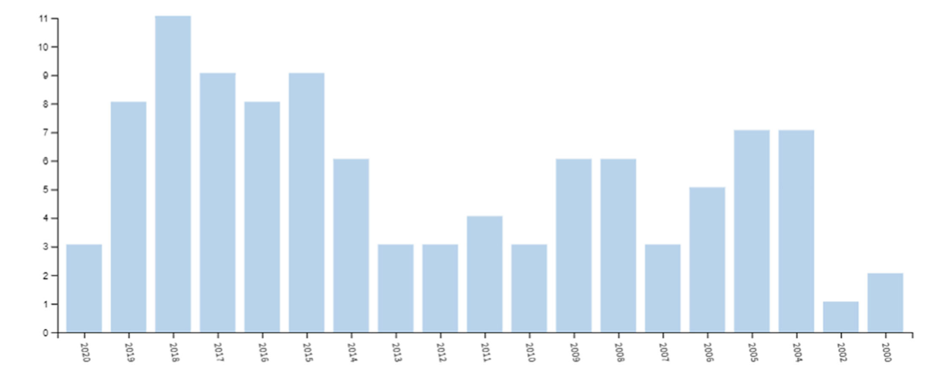
Results
Page 5
Research Trends of data mining privacy preserving concept
Total of 103 publications from 2000 to 2020

Slide 8
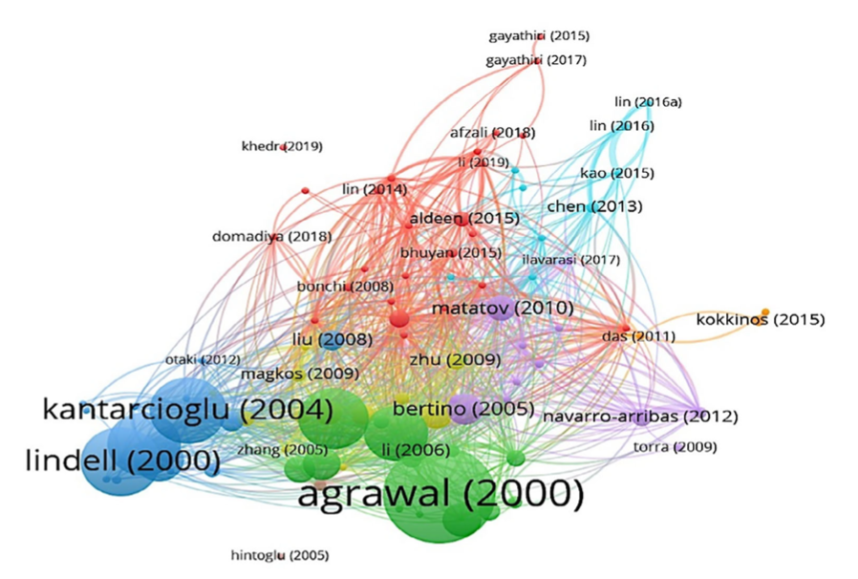
Results
Page 6
Research Trends of data mining privacy preserving concept
Clustering the most influential authors

Slide 9
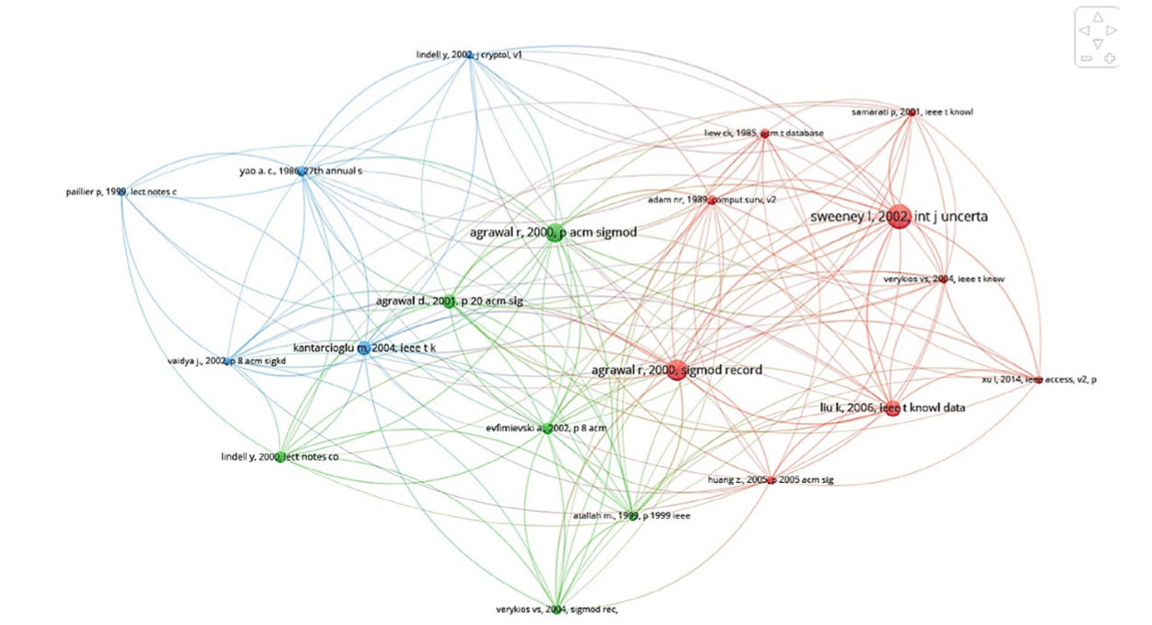
Results
Page 7
Document co-citation analysis
Connection of the citations

Slide 10
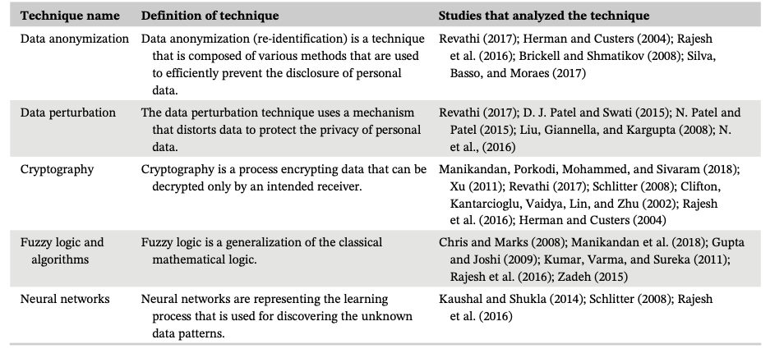
Results
Page 6
Document co-citation analysis
Techniques for PPDM

Slide 11
Results
Page 6
Identification of methods and techniques
Methods of PPDM which are proposed in publications:
Probabilistic Neural Network (PNN) based on Neural Network
Apriori algorithm based on Fuzzy logic and algorithms
K-anonymity based on Data anonymization
Secure Multiparty Computations and Oblivious Transfer based on Cryptography
Noise addition and Randomization based on Data perturbation

Slide 12
Results
Page 8
Identification of methods and techniques
Newly identified Methods of PPDM in publications:
Data Swapping, method based on anonymization technique
Semi-Honest Parties, method based on cryptography technique
Secure Cloud Computing based PPDM technique

Slide 13
Future Research
Page 9
Formally develop a new and more efficient PPDM techniques, methods, approaches, solutions
Identification and optimization of the most optimal PPDM technique
Quantify the PPDM methods and techniques

Slide 14
Conclusion
Page 10
Have successfully uncovered and investigated the development of PPDM
Analysed on research papers from 2000 to 2020 through systematic literature review
Introduced and discussed on various methods and techniques for PPDM use case in publications and studies

Slide 15
Thank You!

